Slide 1

Workshop: Prompt Chaining with LangGraph
Understanding and Implementing Prompt Chaining in AI Workflows

Slide 2
Introduction to Prompt Chaining
What is Prompt Chaining?
Why is it useful in AI workflows?
Overview of LangGraph and LangChain

Slide 3
Prompt chaining
Prompt chaining decomposes a task into a sequence of steps, where each LLM call processes the output of the previous one. You can add programmatic checks (see "gate” in the diagram below) on any intermediate steps to ensure that the process is still on track

Slide 4
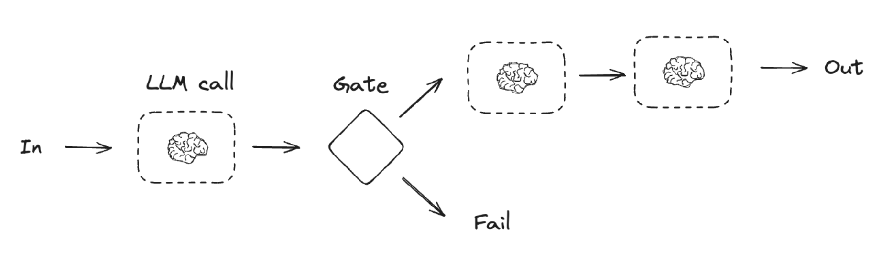
Prompt chaining

Slide 5
Setting Up the Environment
Install dependencies:
pip install langchain langchain-openai langgraph pydantic python-dotenv
Setting up OpenAI API keys using dotenv
Loading environment variables correctly

Slide 6
Understanding LangGraph Basics
What is a StateGraph?
Defining states
Creating nodes and transitions

Slide 7
When to use this workflow
This workflow is ideal for situations where the task can be easily and cleanly decomposed into fixed subtasks. The main goal is to trade off latency for higher accuracy, by making each LLM call an easier task.

Slide 8
Building a Simple Prompt Chain
Creating a basic LangGraph model
Adding nodes and defining logic
Connecting edges and compiling the graph

Slide 9
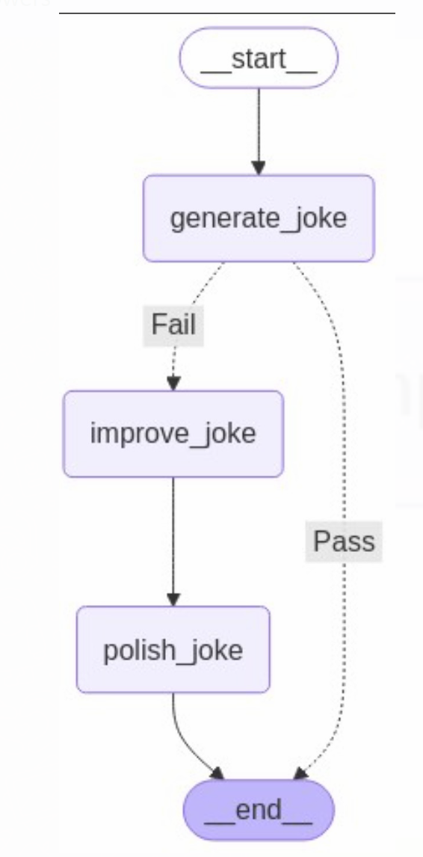

Slide 10
Running and Debugging
Executing the model with sample inputs
Handling errors and debugging common issues
Best practices for efficient prompt chaining

Slide 11
Q&A and Next Steps
Open discussion and participant queries
Resources for further learning
Hands-on challenges for practice

